Slide 1
VSM—Linkage Maps—Idealized Design
The Logic

Slide 2
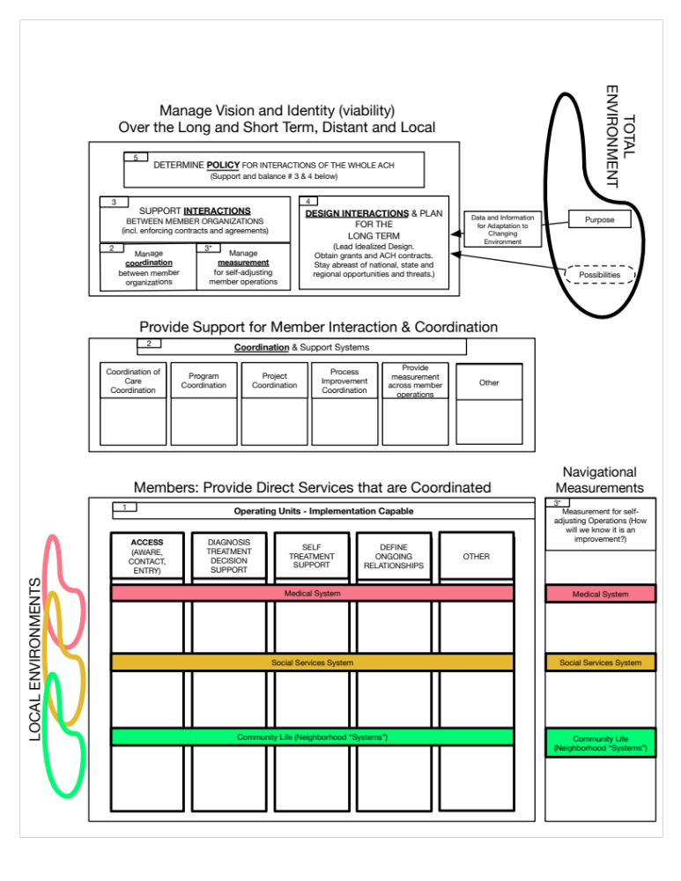
QBS, Interactive Planning & VSM
Integrated

Slide 3
WE WILL END UP WITH
A understandable picture of our whole system of health
  So that we can systematically improve the way we create and maintain health
A cooperative way of making decisions on what to improve together
  Jointly prioritized improvements that we commit to
Shared learning and coordination resources for ongoing improvement

Slide 4
HEALTH IS AN EMERGENT PROPERTY OF
Families, Friends & Peers
Neighbors & Neighborhoods
Communities & Associations
Institutions
  Schools
  Work
  Faith-based
  Government
  NGOs
  Medical Services
  Social Services

Slide 5
SYSTEMS AND SUBSYSTEMS INTERACT
Health and illness emerge from a complex interplay of
  Culture—Community—Social Services—Medical Services
The connections and interactions are at least as important as the individual performance of the parts taken together.
To understand the interactions and improve them we must be able to see them:
  LINKAGE MAPPING.
How to organize the parts and connections into useful “maps” of related parts?
  Mainstay—Client’s perspective (for service delivery)
  Support—Staff’s perspective (for supporting both planning and service delivery functions)
  Driver—Stakeholder’s perspective (for overall planning)

Slide 6
MAPPING THE MAINSTAY
LIST THE PARTS, and then
PROCESS 1
  Start with institutional pain points between institutions
  Work with other institutions to improve the flow between institutions
    Flow included: Clients, Information, Materials
PROCESS 2
  Start with specific clients’ needs (Service Line concept)
  Align them into a system(s)
  Work to improve the flow (sequence) of services needed
  Provide continuity between episodic interactions with the system
PROCESS 3
  Design what you really wish you had and then create that
    (IDEALIZED DESIGN)

Slide 7
DESIGNING THE MAINSTAY
The mainstay consists of the many processes that deliver services to primary clients
(inhabitants, patients, members, eligible recipients, etc.)
Option 1
Current “service lines”
React to problems as they occur
Option 2
Design the processes as you wish they were (Idealized Design)
Move toward that

Slide 8
MAPPING DRIVER LEVEL
Come together based upon shared purposes in a shared complex environment
Plan for important improvements of the interactions between the parts
Develop shared resources based upon value
Manage the plans for improvement to their completion

Slide 9
MAPPING THE SUPPORT LEVEL
(Important coordination functions for the Mainstay and Driver levels)
E.g.
  Information
  Improvement support
  Grant and program support
  Technology infrastructure

Slide 10
IDEALIZED DESIGN
What you really wished you had today! No constraints. No history.
Your Design Building Blocks
  Design Concepts
  Design Requirements
  Design Principles
  Design Components
    WHY (are we doing this together)
    FOR WHOM & WHERE
    HOW (will we get it accomplished)
    WHAT SERVICES

Slide 11
DESIGN CONCEPTS
Transparency—Understandability - Meaningful
Safe
Connected—It is a System
Progress & Continuity

Slide 12
EVERY DESIGN SHOULD ADDRESS/CONSIDER
Age-life stages
Barriers
Communication
Place
Time (of day and week)
Transportation
Professional—Client Relationship

Slide 13
HUMANIZING DESIGN PRINCIPLES
Human—Personal
Convenient
Comprehensive
Teamwork

Slide 14
COMPONENTS / PARTS
WHY
  Purpose
  Experience of care
WHO & WHERE
  Whole Family
  Place matters
  Role of government
WHAT SERVICES
  Basic Needs
  Medical Care

Slide 15
COMPONENTS / PARTS cont.
HOW will it get accomplished
  Expenses and Funding have to match
  Planning
  Organizing
  Communication
  Knowledge & Skills
  Access
  Coordination
  Shared Care Plan

Slide 16
TIMELINE OF A LIFE
(as a reminder, situational awareness)
Pre-conception
Pregnancy-gestation
Birth
Infancy
Early childhood
Working/Raising Family
Senior
End-of-life

